Slide 1
Introduction to the Theory of Games
Rajiv Sethi and the CORE Team
October 11, 2022

Slide 2
Overview
Modeling strategic interactions as games
Strategies and payoffs
Dominant strategies
Best responses
Nash equilibrium
Pareto-Efficiency
Coordination
Reading: The Economy Unit 4 Introduction, 4.1 to 4.3

Slide 3
Half-the-Average
Set of players: all students in this room
Players each can choose a number between 0 and 100 (inclusive)
Could choose 0, or 100, or anything in between, including decimals
Winner is player (or players) whose number is closest to half-the-average
Prize $100 is received by winner (or shared by winners)
All others get nothing
Set of strategies here is the same for each player (and very large)
Payoffs to any player depend on choices by all others
What would you choose?

Slide 4
Golden Balls
British game show (many videos online)
Initial stages result in a jackpot to be split between two contestants
Each is given two balls, one marked split and the other marked steal
Each secretly chooses one of the two and discards the other
If both choose split, they each receive half the jackpot
If both choose steal, they each receive nothing
If one chooses steal and the other split, former gets entire jackpot
Choices are decentralized, one doesn’t know what the other will choose
Link between strategy and payoff profiles represented by payoff matrix

Slide 5
 |  | Carla
 |  | Split | Steal
Rita | Split | Each gets 10,000 | Rita gets 0, Carla 20,000
 | Steal | Rita gets 20,000, Carla 0 | Each gets 0
Jackpot is 20,000

Slide 6
 |  | Carla
 |  | Split | Steal
Rita | Split | (10,000, 10,000) | (0, 20,000)
 | Steal | (20,000, 0) | (0, 0)

Slide 7


Slide 8
Modeling Strategic Interactions

Slide 9
Modeling Strategic Interactions
Some decisions require us to reason about the reasoning of others
Whether an action is a good or bad idea may depend on actions of others
Interactions of this kind are strategic
Game theory is a language for analyzing such situations
Example: consider earlier case of study time and grades
If grades are curved, your grade depends on study times of others
Example: spectrum auction (companies bid for rights to transmit signals)
Key components of a game: players, strategies and payoffs

Slide 10
Example
Two farmers: Anil and Bala
Two crops: rice and cassava
If both produce the same crop, market glut, low prices
So specialization is better for both
Anil has absolute advantage in cassava, Bala in rice
Ideal outcome: each specializes in accordance with advantage
Different outcome: each specializes in the wrong crop
Other outcomes: both produce same crop (either rice or cassava)
Choices are decentralized, they don’t know what the other will choose

Slide 11
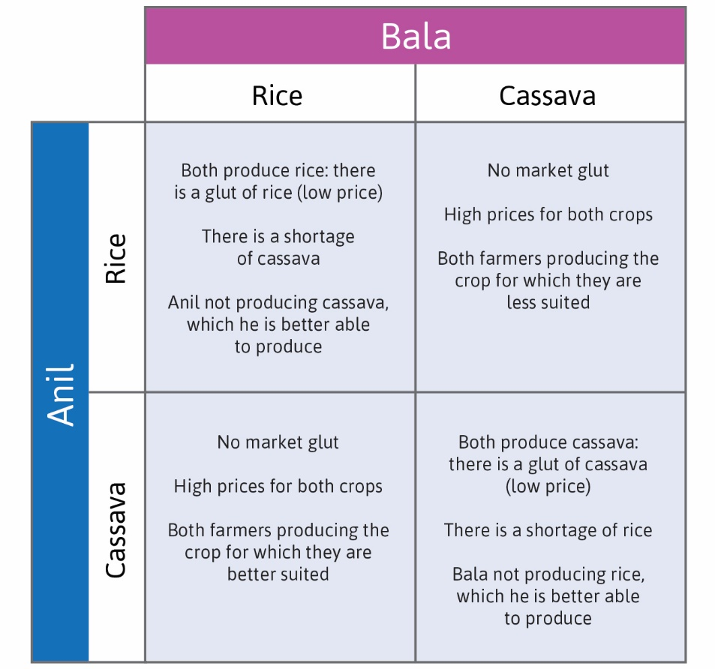

Slide 12
Payoffs
If Anil grows cassava and Bala grows rice they each get 4 (ideal)
If Anil grows rice and Bala grows cassava they each get 2 (not so good)
What if they both grow the same crop?
Consider two cases, A and B
Case A: the payoffs are 3 and 1 (the one with advantage gets 3)
Case B: the payoffs are 1 and 0 (the one with advantage gets 1)
Game theory makes very different predictions in these two cases
They are strategically different: let’s see why, staring with Case A

Slide 13
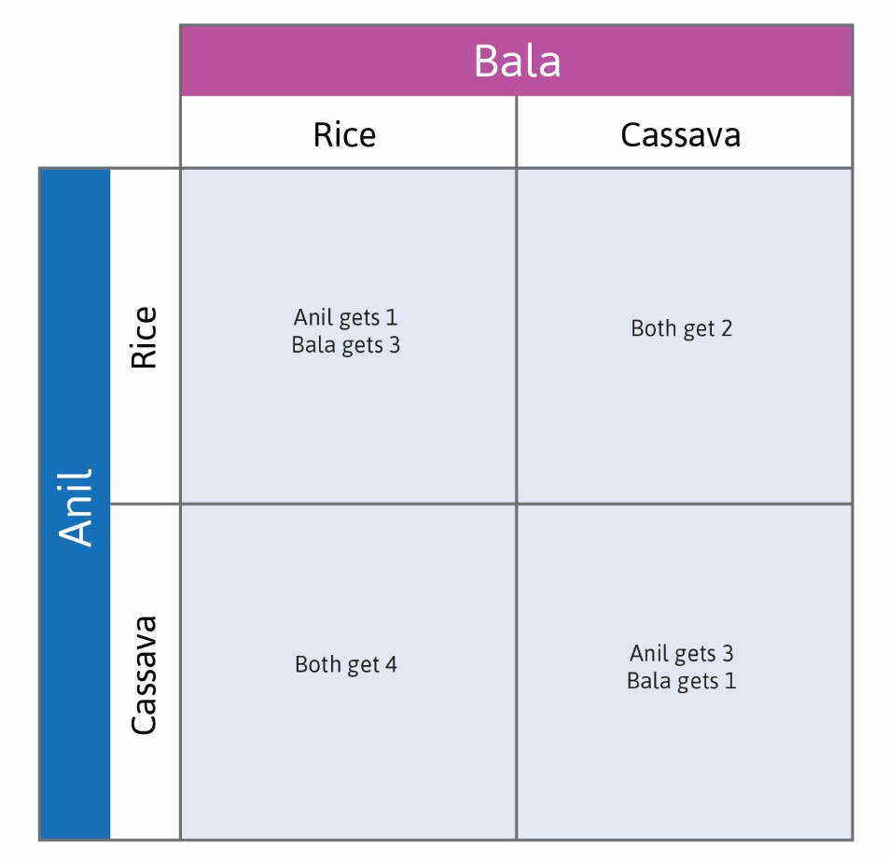

Slide 14
Payoff Matrices
Payoffs in two-player games can be shown using a matrix
One player chooses (the row player) chooses a row
The other player (column player) chooses a column
These choices pin down a cell in the matrix
And determine the payoffs to both players
Suppose Anil is the row player, Bala is the column player

Slide 15
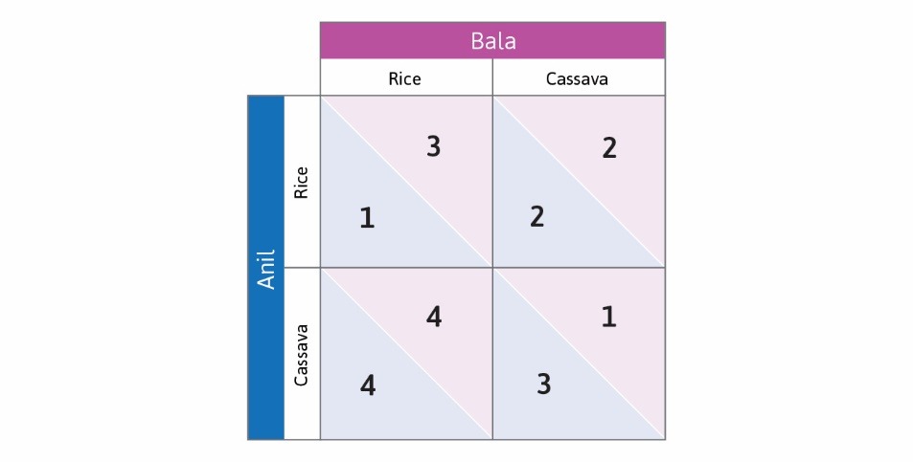

Slide 16
Best Responses

Slide 17
Best Responses
For each strategy chosen by Bala, Anil has a best response
Example: if Bala chooses rice, Anil’s best response is cassava
Similarly, for each strategy chosen by Anil, Bala has a best response
Let’s identify all best responses (Anil with bullet, Bala with open circle)

Slide 18
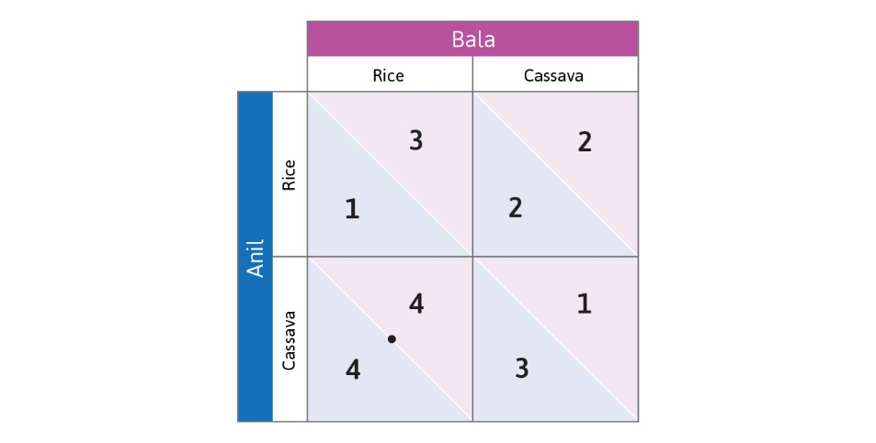

Slide 19


Slide 20


Slide 21


Slide 22
Dominant Strategies

Slide 23
Dominant Strategies
In Case A, each player’s best response is always the same
Anil’s best response is always cassava, Bala’s best response is always rice
In this case we say that both players have a (strictly) dominant strategy
A dominant strategy is a best response to every opponent strategy
If both players choose dominant strategies we have an equilibrium
This is called a dominant strategy equilibrium
There can be at most one dominant strategy equilibrium in a game
So in Case A, game theory predicts the ideal outcome
What about Case B?

Slide 24


Slide 25


Slide 26
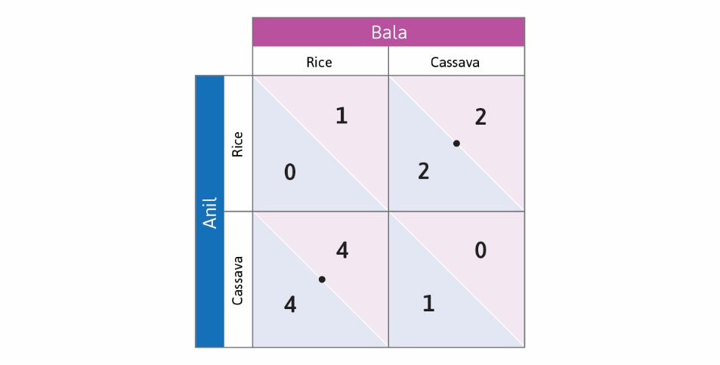

Slide 27
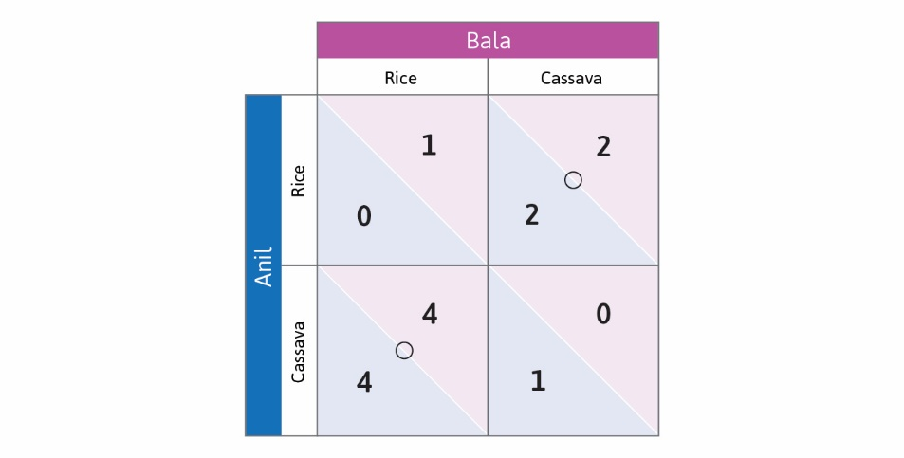

Slide 28


Slide 29
Nash Equilibrium

Slide 30
Nash Equilibrium
In Case B, neither player has a dominant strategy
For each player, cassava is a best response to rice
And rice is a best response to cassava
So what does game theory predict?
Consider a profile of strategies, one for each player
Example: (Cassava, Rice) is a strategy profile, as is (Rice, Rice)
Profile is a Nash equilibrium if each strategy is best response to the other
No player has incentive to deviate unilaterally from a Nash equilibrium
How many Nash equilibria are there in Case B?

Slide 32
Pareto-Efficiency

Slide 33
Pareto Efficiency
In both cases, the strategy profile (cassava, rice) is best for both players
Each specializes where they have advantage, each gets payoff 4
No other profile leaves them both better off
A profile is Pareto-inefficient if there’s an alternative that all prefer, or that some prefer and others like just as much
If there’s no such alternative, then the profile is Pareto efficient
The profile (cassava, rise) in this example is Pareto-efficient
In Case A, this also happens to be the unique Nash equilibrium
In Case B, there’s also a second equilibrium that’s inefficient

Slide 34
Equilibrium and Efficiency
We have seen that a Pareto-inefficient equilibrium can exist
But in Case B, the Pareto-efficient profile is also an equilibrium
Can it be that case that a unique equilibrium is inefficient?
Can a dominant strategy equilibrium be inefficient?
The following example shows that the answer to both questions is yes

Slide 35
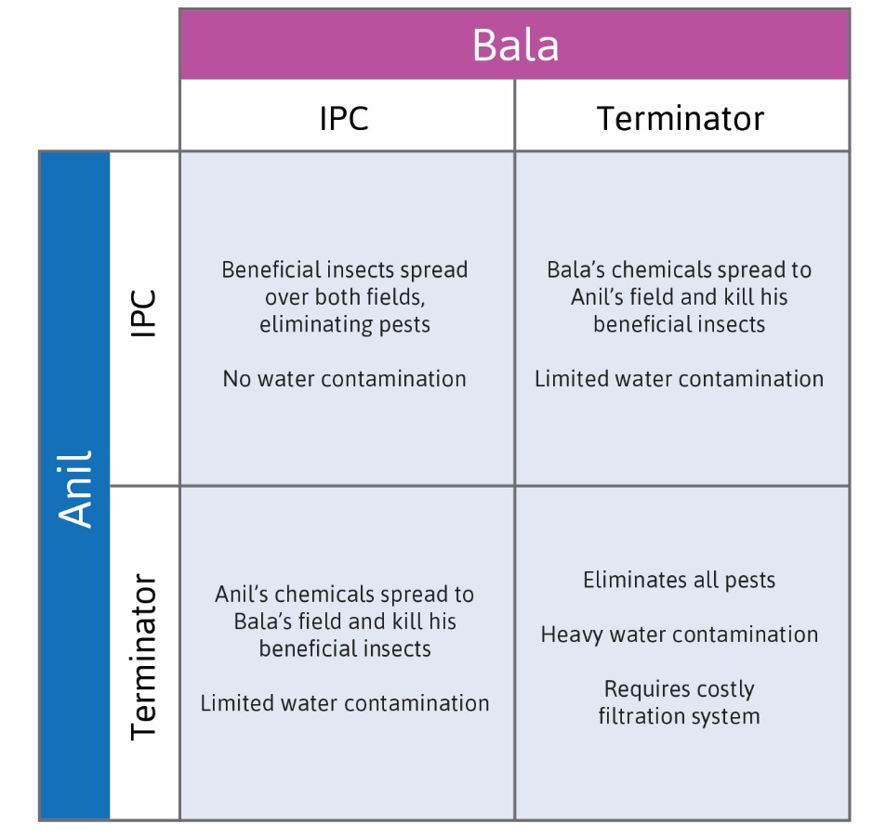

Slide 36


Slide 37
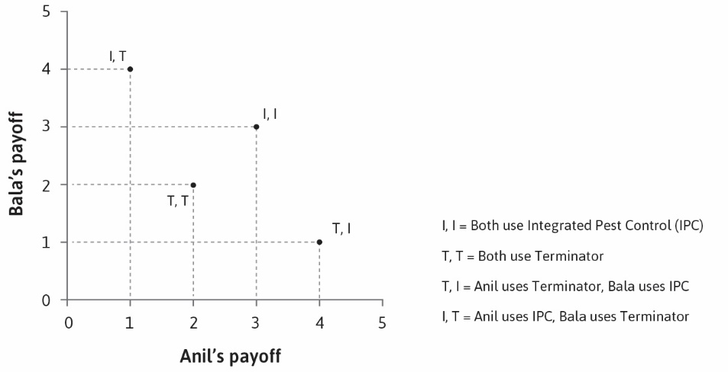

Slide 38
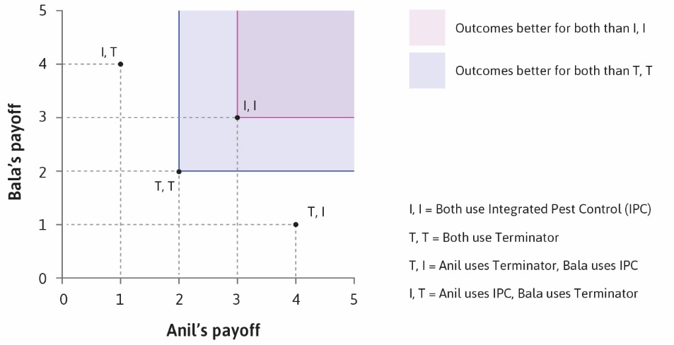

Slide 39
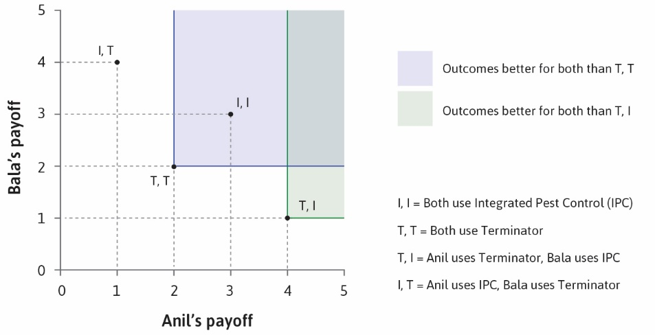

Slide 40
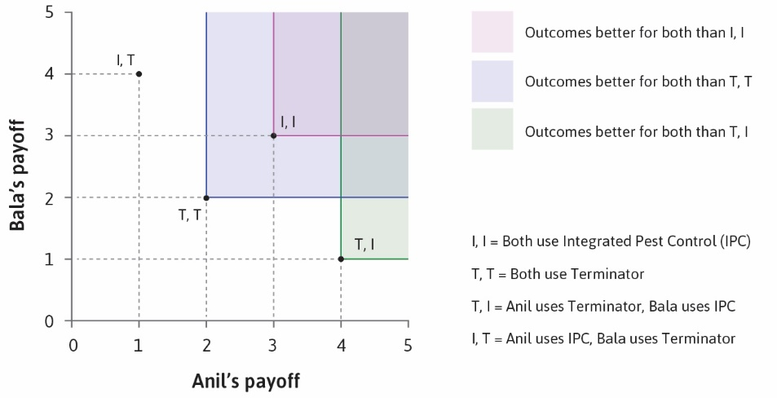

Slide 41
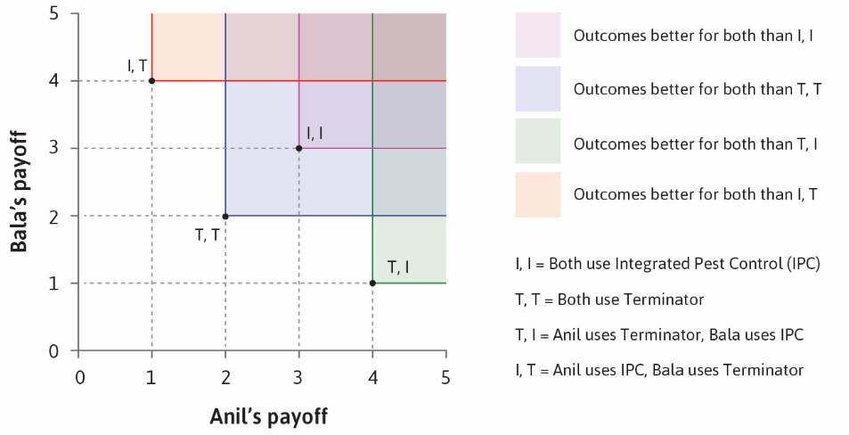

Slide 42
Coordination
Some situations require players to choose compatible actions
Example: Driving on the left or right of the street
Example: Using the same matching platform (job search, dating, etc.)
Example: Using the same programming language
Such coordination games have multiple Nash equilibria
Even if all are efficient, players may prefer different equilibria

Slide 43
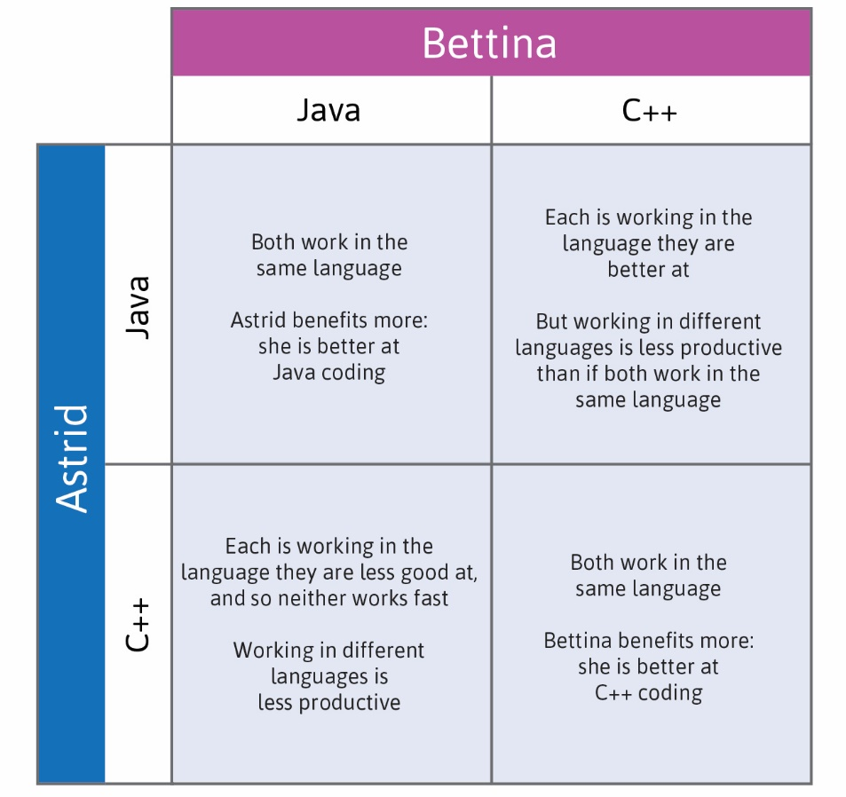

Slide 44
